Slide 1
Java Persistence API (JPA)

Slide 2
What is JPA?
JPA is just an specification from Sun, which is released under JEE 5 specification.
JPA standardized the ORM persistence technology for Java developers.
JPA is not a product and can't be used as it is for persistence. It needs an ORM implementation to work and persist the Java Objects.
ORM frameworks that can be used with JPA are Hibernate, Toplink, Open JPA etc.

Slide 3
What is JPA?
Java Persistence API or JPA for short is a lightweight, POJO-based Java framework to persist the Java Objects to the relational database.
JPA is uses metadata to map the persistence objects with the database table.
JPA supports SQL like query language to ease the process of querying the database.

Slide 4
The benefits of JPA
Simplified Persistence technology
ORM frameworks independence:
Any ORM framework can be used
Data can be saved in ORM way

Slide 5
ORM frameworks
Here are the list of ORM frameworks that can be used with JPA specification.
  Hibernate
  Toplink
  iBatis
  Open JPA

Slide 6
Why JPA?
JPA is standardized specification and part of EJB3 specification
Many free ORM frameworks are available with can be used to develop applications of any size
Application developed in JPA is portable across many servers and persistence products (ORM frameworks).
Can be used with both JEE and JSE applications
JSE 5 features such as annotations can be used
Both annotations and xml based configuration support

Slide 7
JDBC Vs ORM

Slide 8
What is JDBC?
JDBC stands for Java Database Connectivity, is a set of Java API for accessing the relational databases from Java program.
The Java API enables the programmers to execute the SQL statements against the JDBC complaint database.
JDBC allows the programmers to quickly develop small Java applications that interact with the databases.
To develop an application programmer has to develop the code to connect to the database and then write the code to execute the query.
Once the query is successfully executed and result is retrieved from the database, programmer can read the data programmatically from the result set object.

Slide 9
Advantages of JDBC
Clean and easily for small programs
JDBC provides good performance with large amount of data
Small JDBC programs can be developed very easily
Very good for small applications

Slide 10
Disadvantages of JDBC
JDBC is not easily if it is used in large projects. There is a big programming overhead.
Programmer must hardcode the Transactions and concurrency code in the application.
Handling the JDBC connections and properly closing the connection is also a big issue. Properly closing the connection is must.
JDBC is not good for big applications

Slide 11
What is ORM?
ORM stands for Object Relational Mapping, is another technology to access the data databases.
Here business object is directly mapped to the database tables with the help of ORM framework.

Slide 12
Advantage of ORM
No need to deal with the SQL Queries to save and retrieve the data
Simple configuration
Standardized API to persist the business objects
Fast development of application
Excellent cashing support for better performance of the application
Easy to learn and use

Slide 13
Disadvantages of ORM
Slow performance in case of large batch updates
Little slower than JDBC

Slide 14
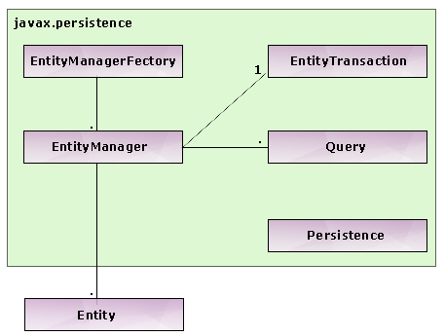
JPA Architecture

Slide 15
Entity
Entity is the persistence (POJO) objects that represent one record in the table.
The Entity is simple annoted POJO class, which is easy to develop.
Here are the characteristics of an Entity:
  Entity can be persisted to the relational database
  Entity is identified by persistence identity (the primary key of the table)
  Entity supports transactions
  Entity supports inheritance

Slide 16
EntityManager
The EntityManager interface is providing the API for interacting with the Entity. Some of the functions provided by EntityManager API are:
persist : this method is used to save a new entity
merge : this method is used to update the sate of entity into database
remove : this method is used to remove the entity instance

Slide 17
EntityManagerFactory
The EntityManagerFactory is used to create an instance of EntityManager. In your application when there is no use of EntityManagerFactory or application shuts down then it is necessary to close the instance of EntityManagerFactory . Once the EntityManagerFactory is closed, all its EntityManagers are also closed.

